Slide 1
Topic: Stem and leaf plots EQ: How do we draw and analyse stem and leaf plots?
Year 11 Essentials

Slide 2
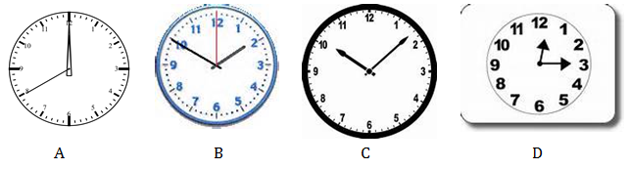
Five Questions
Topic: Stem and Leaf Plots
EQ – How do we draw and analyse stem and leaf plots?
Jenny wants to paint a wall in her house, which is 80 square metres in area. If paint comes in 4 L tins and each tin covers 7 square metres, how many cans will Jenny need to buy?
2) Robbie’s weekly pay of $1600 is increased by 17%. Approximately what is his new pay?
3) Mrs Green starts to summarize her Algebra lesson for the day at 8 minutes past 10. Which clock shows the correct time?
4) 99800, 99820, 99840, 99860, _______
Write the number next in the sequence.
5) The price of a refrigerator is marked as $1500. What would be the sale price after a discount of 20%?

Slide 3
24
7
30
Topic: Stem and Leaf Plots
Date: XX/XX/2021
EQ – How do we analyse and draw stem and leaf plots?
What is a Stem and Leaf plot?
Stem and Leaf plots are used to display a single data set or two related data sets.
They help to show distribution like histograms
Median and mode can easily be read as the data is in order
WICOR

Slide 4
24
7
30
Topic: Stem and Leaf Plots
Date
EQ – How do we draw and analyse Stem and Leaf Plots?
The Data is shows in two parts: the Stem and the Leaf
The Stem is the tens part of the number (left side)
The Leaf is the units part of the number (right side)
Eg: 26
Look at your data set and see how many numbers you will need in the stem section
Eg: 10, 12, 14, 26, 28, 39, 40, 50, 57, 68
Fill in the leaf section of the plot
How do we draw Stem and Leaf Plot?
2 6
1 0, 2, 4
2 6, 8
3 9
4 0
5 0, 7
6 8
1
2
3
4
5
6
WICOR

Slide 5
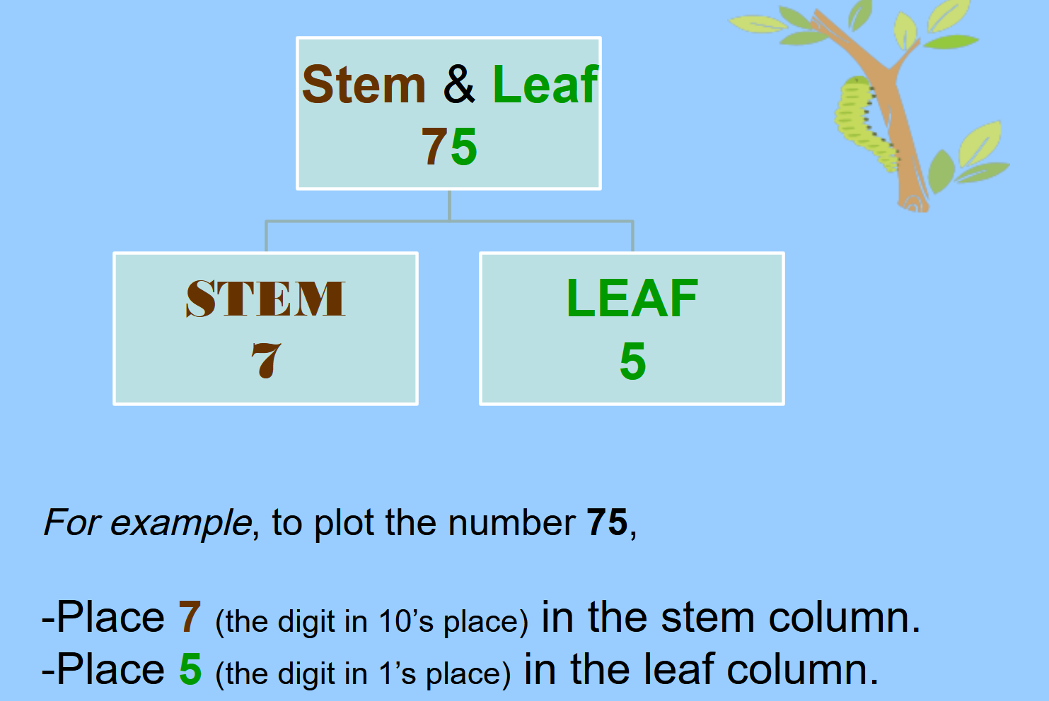

Slide 6
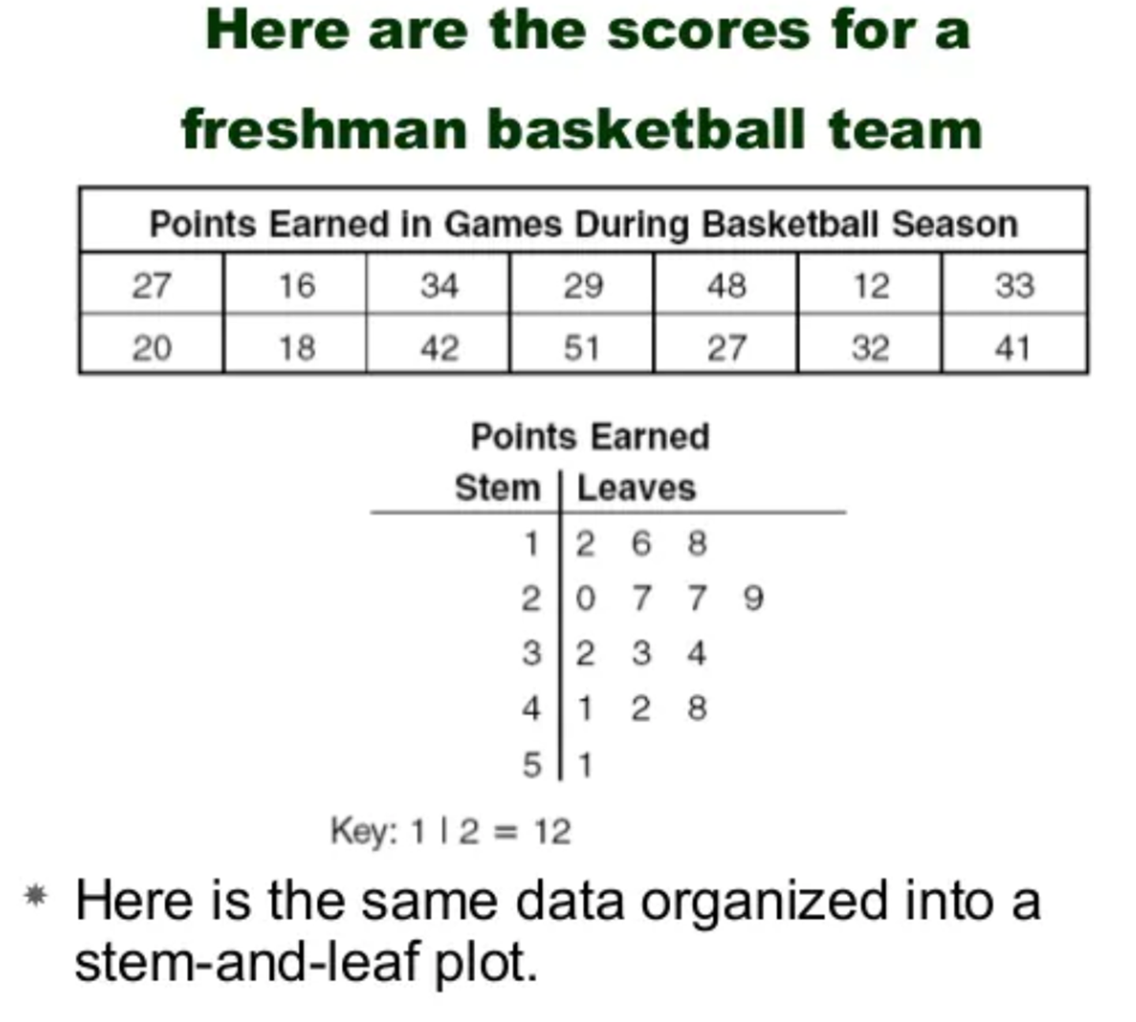
24
7
30
Topic: Stem and Leaf Plots
Date: XX/XX/2021
EQ – How do we analyse and draw stem and leaf plots?
WICOR

Slide 7
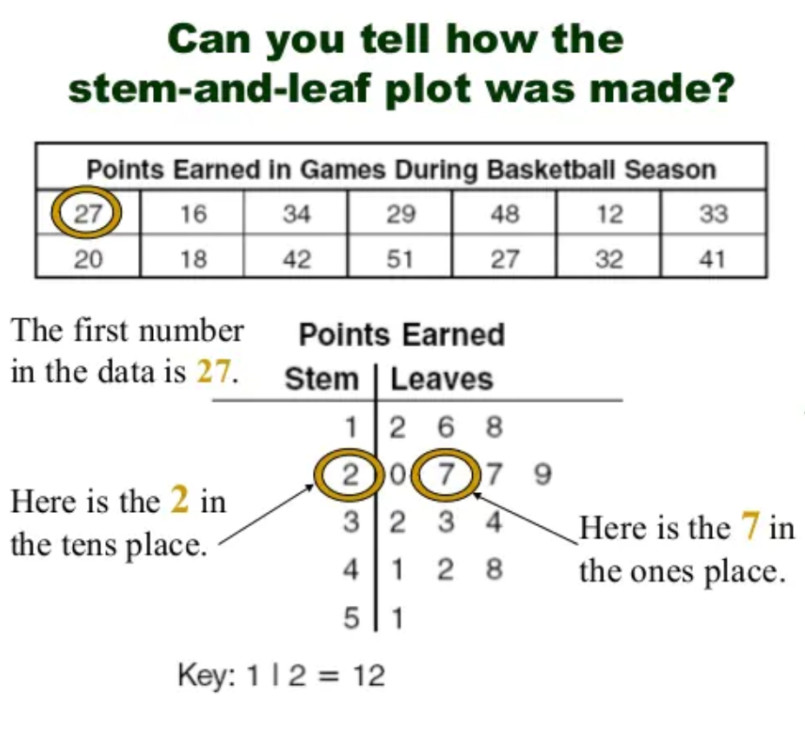
The key shows us which place value the digit represents

Slide 8
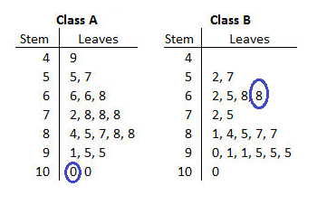
What does the circled numbers represent?
Key: 5|2=52
100 68
Notes:
Check for understanding

Slide 9


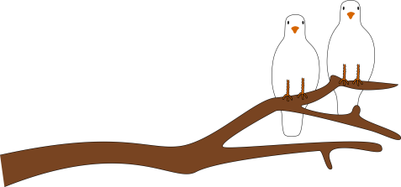
LETS DO ONE TOGETHER:
Put the following data into a stem and leaf plot
5, 6, 7, 8, 8, 10, 11, 11, 12, 15, 16, 17, 21, 23
Title
Stem
Leaves
Key: 2|3 = 23
0
1
2
5 6 7 8 8 0 1 1 2 5 6 7
1 3
5
Notes:
Non ordered data

Slide 10
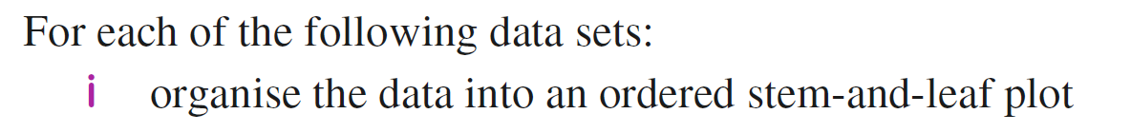
Practice

Slide 11
24
7
30
Date
Topic: Stem and Leaf Plots
EQ – How do we analyse and draw stem and leaf plots?
Questions
Notes
Explanations
How do I find the mode from a stem and leaf plot?
Data
Look to the leaf data and identify the most frequently occurring number.
Bring the stem and leaf together for the answer.
Remember to check if there is ore than one mode.
Key: 1|2=12
0
1
2
3
5
2 8 8
2 3 6
2 5
Mode = 18
WICOR
5

Slide 12
24
7
30
Date
Topic: Stem and Leaf
EQ – How do we analyse and draw stem and leaf plots?
Questions
Notes
Explanations
How do I find the median from a stem and leaf plot?
Data
Count the number of data points.
Add one and divide by 2. This is the position of the median. If you get a remainder (e.g. 4.5) the median will be the average of the numbers at the two places either side of that position
Count the leaves from the top.
Key: 1|2=12
0
1
2
3
5
2 8 8
2 3 6
2 5
Median = 22
WICOR
5

Slide 13
24
7
30
Topic: Stem and Leaf
Date
EQ – How do we analyse and draw stem and leaf plots?
Questions
Notes
Explanations
How do I find the range from a stem and leaf plot?
Data
The first leaf is the minimum.
The last leaf is the maximum. (Make sure you include the stem).
The range is the maximum subtract the minimum.
Key: 1|2=12
0
1
2
3
5
2 8 8
2 3 6
2 5
Range = 35 – 05 = 30
WICOR
5

Slide 14
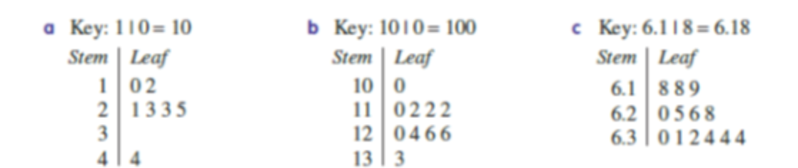
LHS
Find the median and range of each data set

Slide 15
Stem and leaf plot representation
Ten students read the following number of books: 6, 7, 10, 12, 12, 15, 19, 21, 23, 25. Each number is represented on the stem and leaf plot below.
Stem Leaf
0 6 7
1 0 2 2 5 9
2 1 3 5
Explore:
How do you think the stem and leaf plot was made from he raw data? What are the stems? What are the leaves?
Which “stem” had the most leaves?
Where is 21 on the stem and leaf plot? How did you know?
Examine the order of the digits in the Leaf section. What do you notice

Slide 16
Experiment
Collect height data for the students in your class in centimetres. Write the data in order from smallest to largest. Use the data to create a stem and leaf plot for height, with stem for the first two digits of the number and leaf from the final digit

